Slide 1
Predicting Customer Purchase Behaviour
Revanth Kumar Santi

Slide 2
Data Info
Shape:1500*9
Null Values: No
Duplicate Values: Yes
Datatype: numerical
Shape of data after preprocessed:1388*9

Slide 3
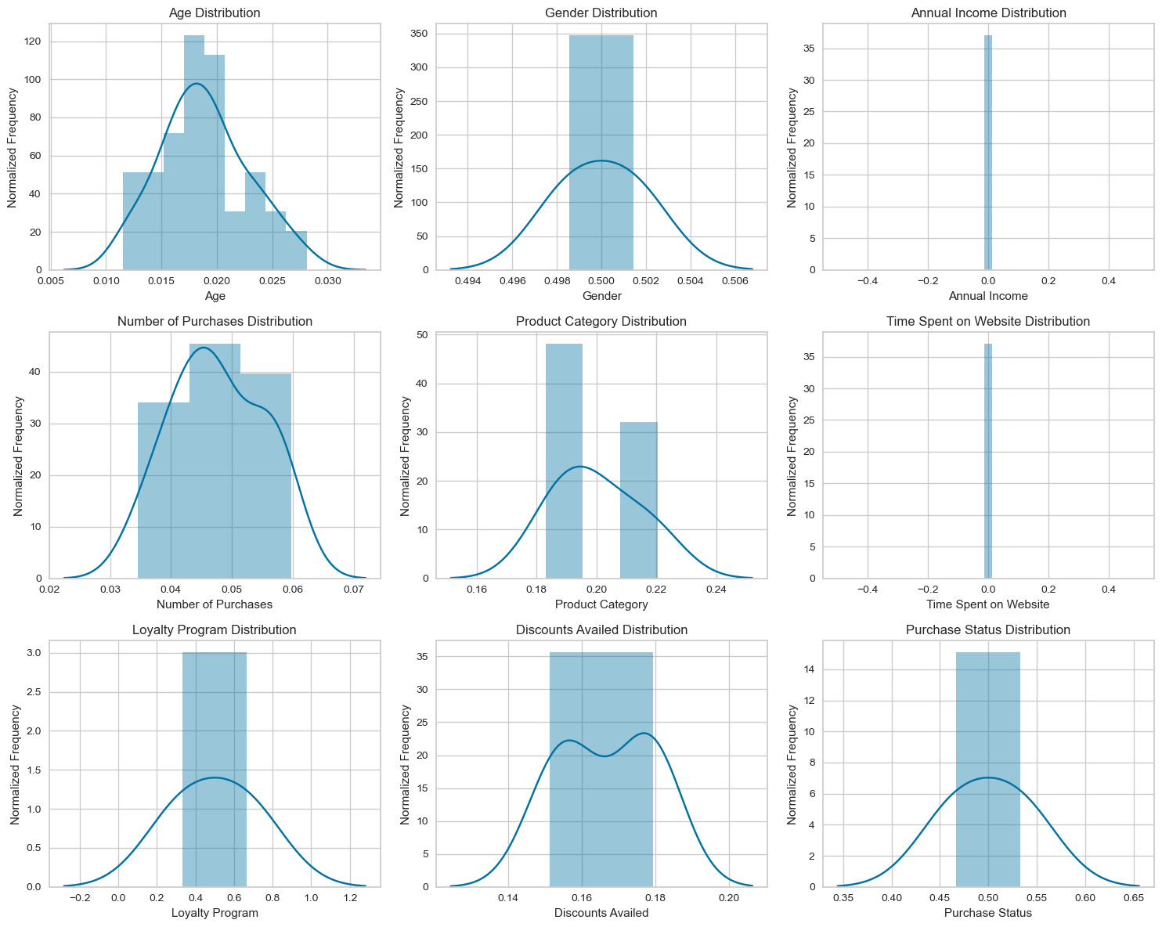
Distribution

Slide 4
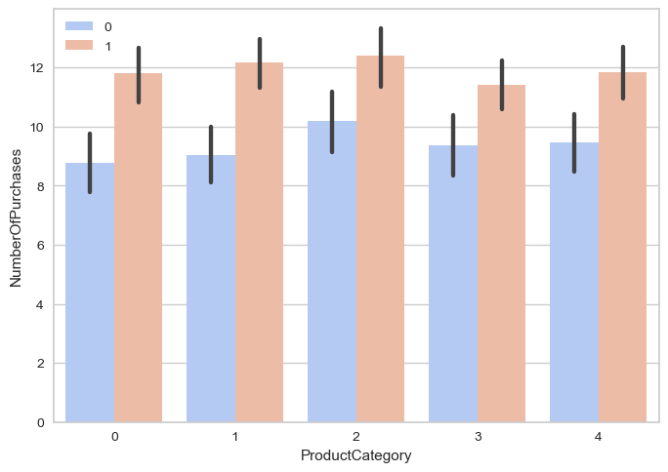
Product Category Vs Number of Purchases
Across all product categories, the likelihood of making a purchase (orange bars) is higher than not making a purchase (blue bars).
This suggests that customers are generally more inclined to make purchases regardless of the product category.

Slide 5
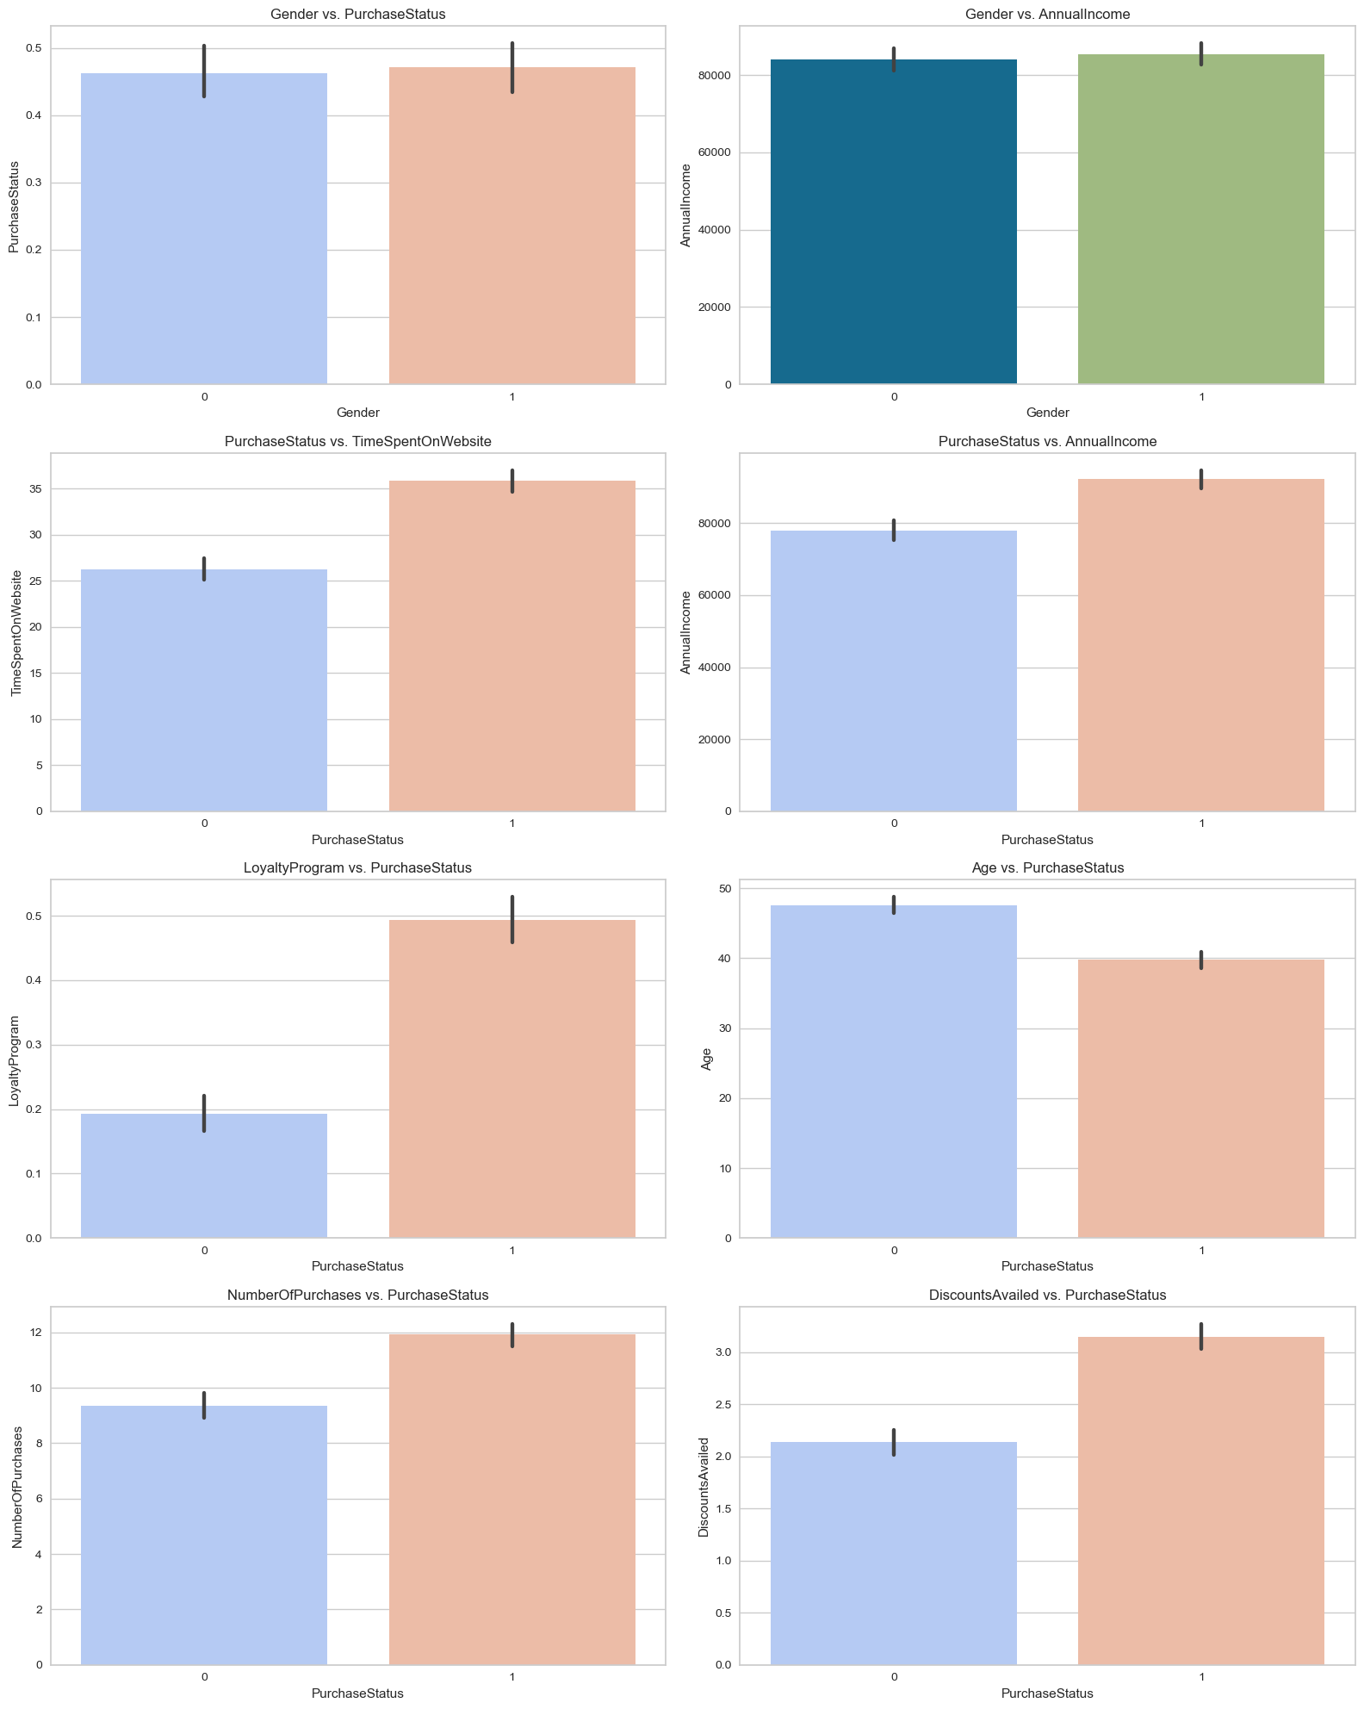
Gender pays no contribution on number of Purchases.
Higher income correlates with a higher likelihood of making a purchase.
Spending more time on the website increases the chances of making a purchase.
Loyalty program members are more likely to make purchases.
Customers who avail more discounts are more likely to make purchases.
Lower age groups are more likely to make purchases than higher age groups.

Slide 6
Model Selection
Using Pycaret: PyCaret is an open-source, low-code machine learning library in Python that automates machine learning workflows.
Best Model: Categorical Boosting Classifier with accuracy of 94% after tuning

Slide 7
Thank You

